Slide 1

HCI - Assignment n.2
Project Title: StudySync
Group: Gonçalo Cunha nº108352 José Cerqueira nº76758 Vasco Rodrigues nº109211
Lab Class: P2
HCI 2023-2024

Slide 2
Introduction
StudySync
StudySync is a tailored solution for university students seeking effective time management and organization, with implemented gamification elements.
We've experienced firsthand the struggle of balancing academic demands with personal commitments. StudySync addresses this challenge head-on, providing tools for scheduling, task management and progress tracking, and fitting incentives in the form of currency, used to buy items, a login bonus for completing tasks daily, and a ranking system
StudySync potential lies in its ability to enhance student success and well-being.
HCI 2024-2024
2

Slide 3
Project Objectives
StudySync
Goals: Simplify academic scheduling and task management - Provide students with intuitive tools for organizing their academic responsibilities effectively.
Outcomes: Foster increased accountability, better time management, and improved academic performance
Benefits: Enhance efficiency, convenience and empowerment.
HCI 2024-2024
3

Slide 4

Personas
Eusébio, 20
2nd year Physics student with bad time awareness
Problems – Forgets exam dates, project deadlines and misses classes
Goals – Prepare for exams ahead of time and improve project management, regularly attend classes
Needs – To be able to create a study plan, set up deadlines and priorities for each task, track progress, evaluate performance, and schedule classes
HCI 2023-2024
4

Slide 5
Scenarios
StudySync
Scheduling study plan for test
Wants to plan a progressive study plan with notifications to remind him of any deadlines.
Improve attendance Wants to became a better student by not missing any class, and needs a reminder to focus and motivate her.
Get rewarded Get incentives to keep being productive
HCI 2023-2024
5

Slide 6
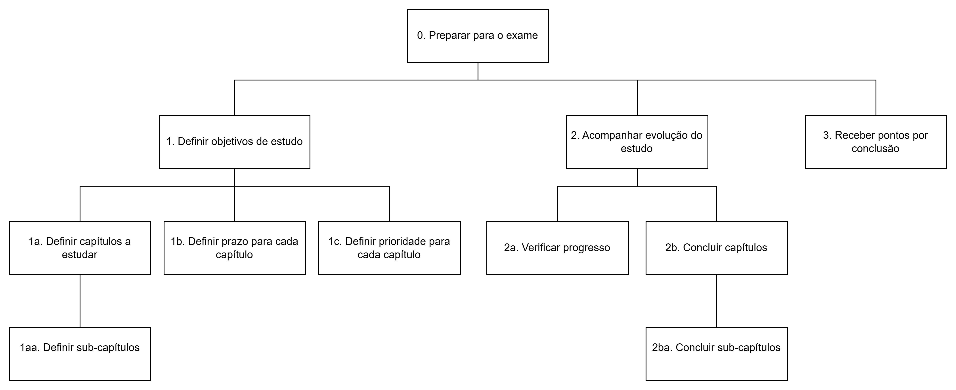
Task analysis
StudySync
Scheduling study plan for test
HCI 2023-2024
6

Slide 7
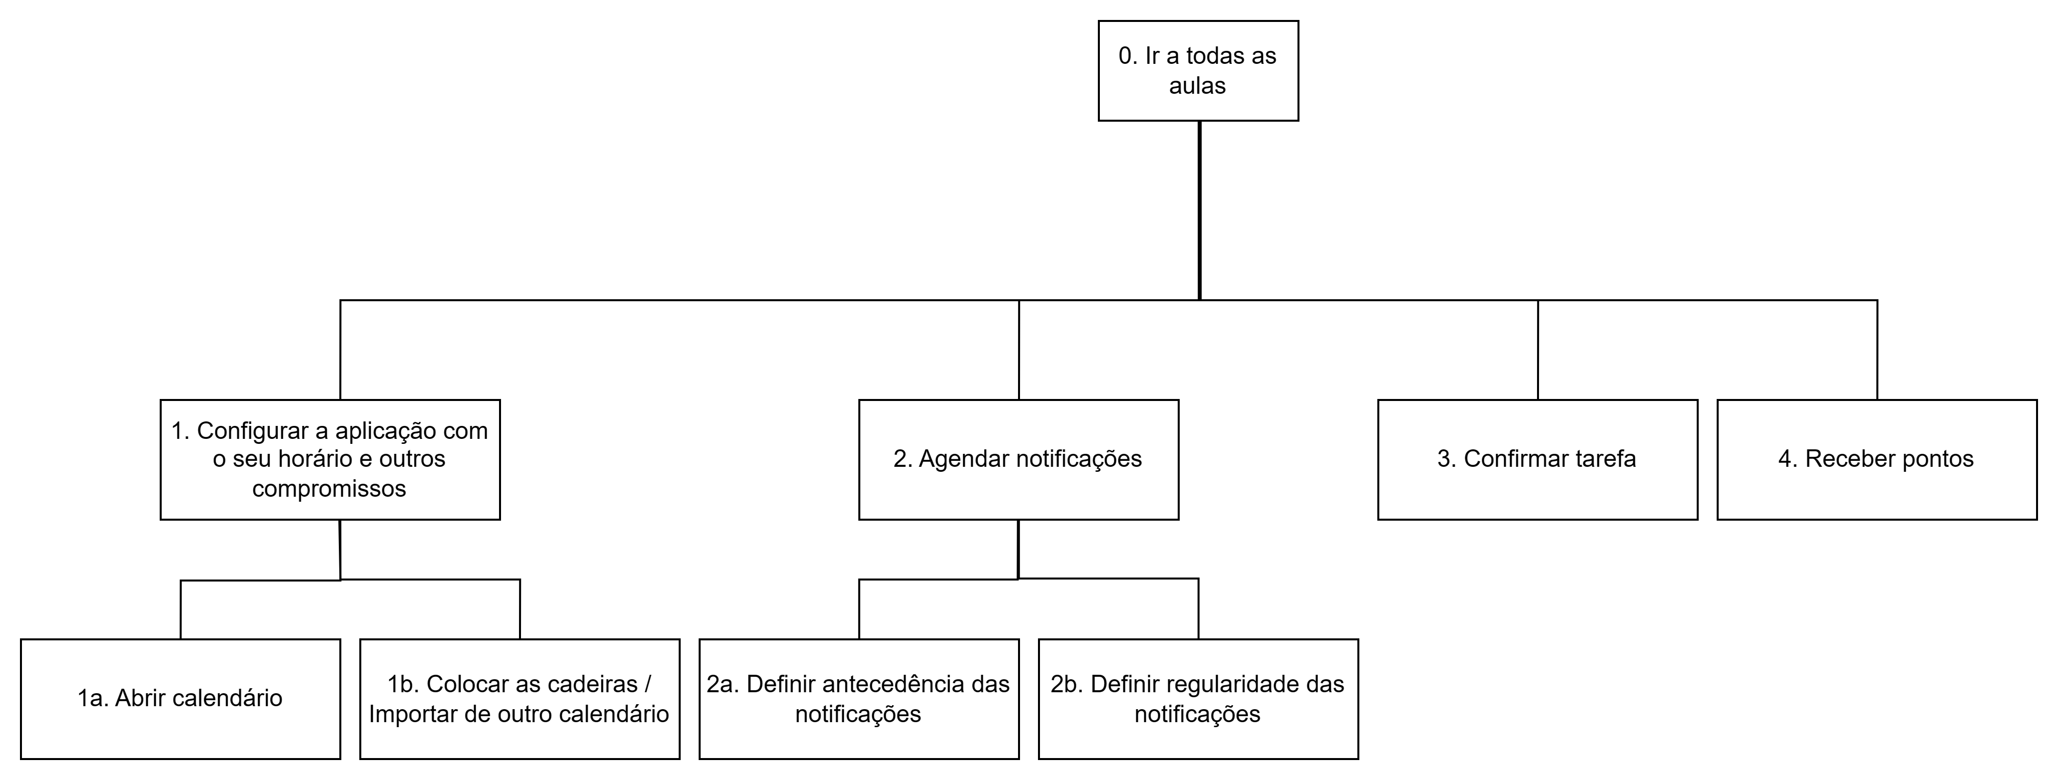
Task analysis
StudySync
Improve attendance
HCI 2023-2024
7

Slide 8
Scenarios
Get rewards
Complete daily login
Use currency to buy items
HCI 2023-2024
8

Slide 9
Requirements
StudySync
Functional requirements
Create and manage school calendar
Reward user with currency for accomplishing tasks/objectives
Schedule and receive alerts for exams and projects
Create tasks, subtasks and multi-step tasks and mark them as completed
Set goals and check weekly and monthly stats
Use currency to buy cosmetic items
Define the class schedule and check into classes
HCI 2023-2024
9

Slide 10
Requirements
StudySync
Non-functional requirements
Recoverability – ensures that the app can recover all the data after the system failure or restore the system to certain parameters;
Scalability – determines that the app will continue functioning properly after its size or volume changes;
Usability – defines how easy a user can interact with the app’s interface, e.g. the screen color, buttons size, etc.;
Capacity – assesses the amount of data or services the app can handle
Security – defines how secure the app should be
HCI 2023-2024
10

Slide 11
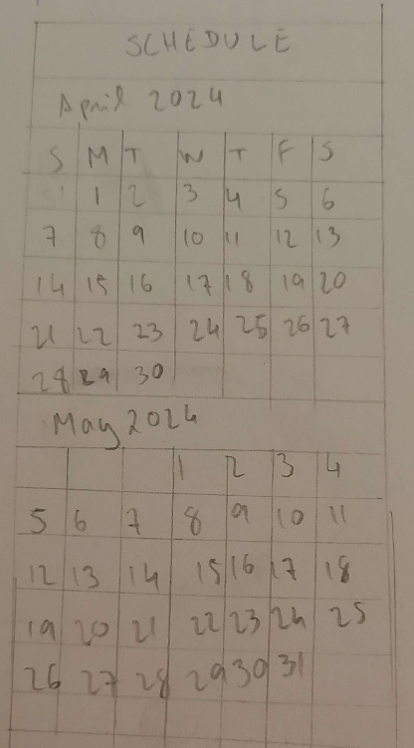
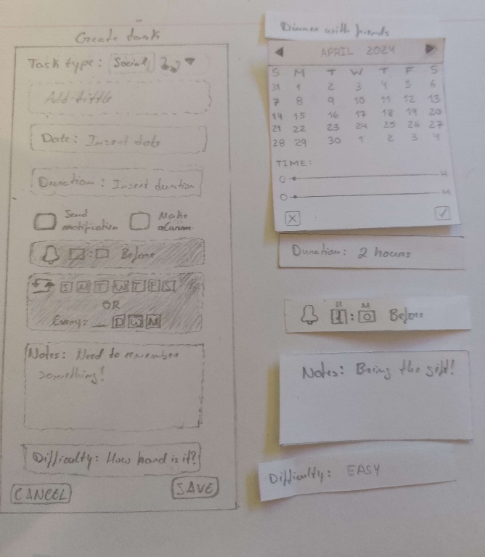
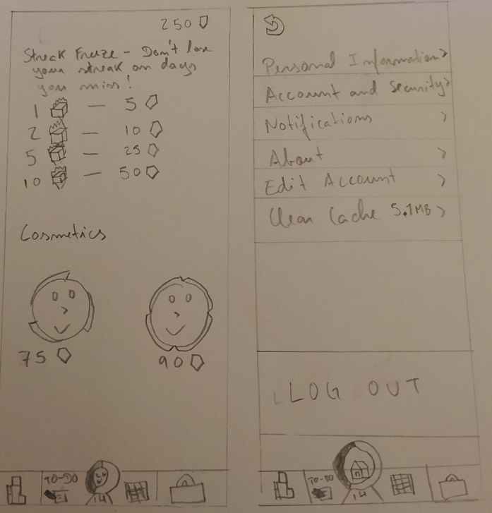
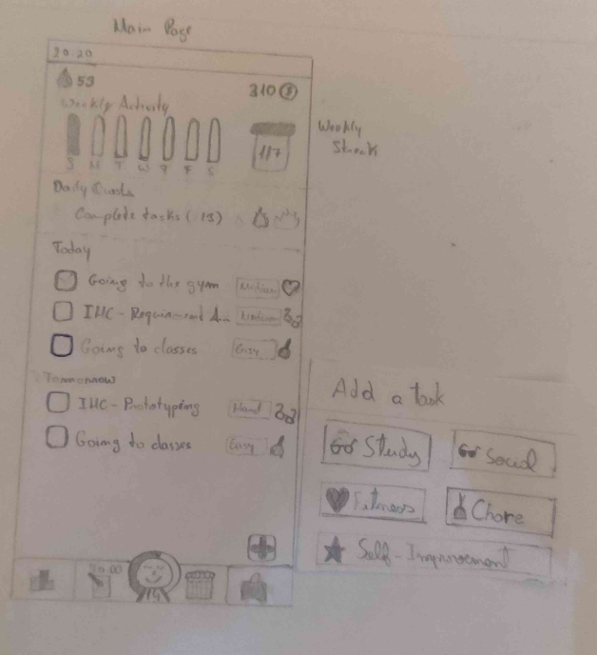
Low Fidelity Prototype

Slide 12
User Evaluation – Low Fidelity Prototype
Goal
Evaluate the system navigability
Tasks
Add a task tagged as social for next Friday to remember to bring a present to a birthday party and mark the difficulty as easy.
Check the calendar to know how busy you are for next week
Enter the store and purchase a custom frame and afterwards equip said frame
Check the leaderboard to see if you’re going to be promoted to the next rank
Logout from the app

Slide 13

Low Fidelity Prototype Feedback
Lack of clear home and profile button
Should only show today’s tasks on home screen
Make clear distinction between tabs (tasks and calendar)
Add option for task repetition
Confusing leaderboard (rewards mistaken for score)

Slide 14
User evaluation – high fidelity prototype
Tested the same tasks
Same number of participants as the low fidelity prototype

Slide 15




Functional prototype – platforms used
Vscode
React (javascript library)
Vite
Npm

Slide 16
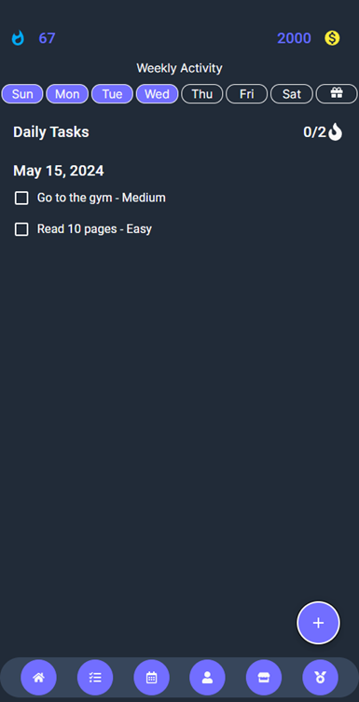
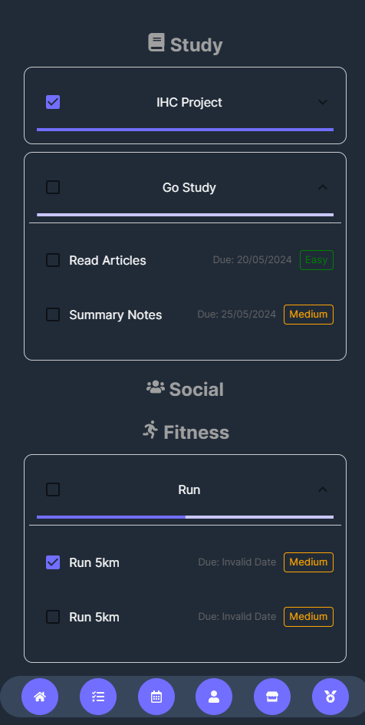
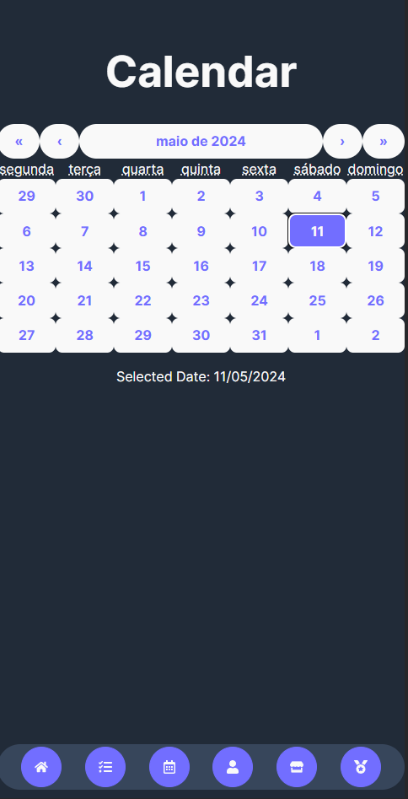
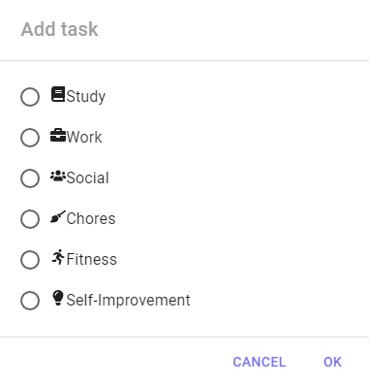
Functional Prototype

Slide 17
Functional Prototype Feedback
Hard to read due to colors
Difficulty finding settings
Sort/divide the cosmetics by type

Slide 18
Functional prototype – heuristic evaluation
Usability Problem | Heuristic | Severity Degree
Lack of feedback when buying items | Recognition rather than recall | 2
Difficulty finding settings | Visibility of system status | 3
Inconsistency in profile page (horizontal & vertical scroll) | Consistency and Standards | 1

Slide 19
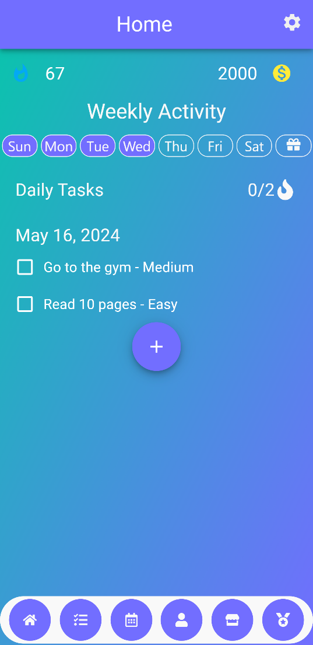
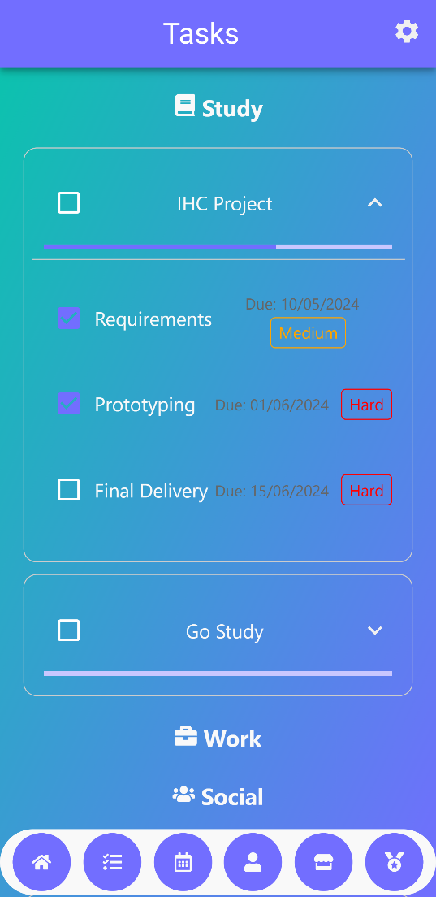
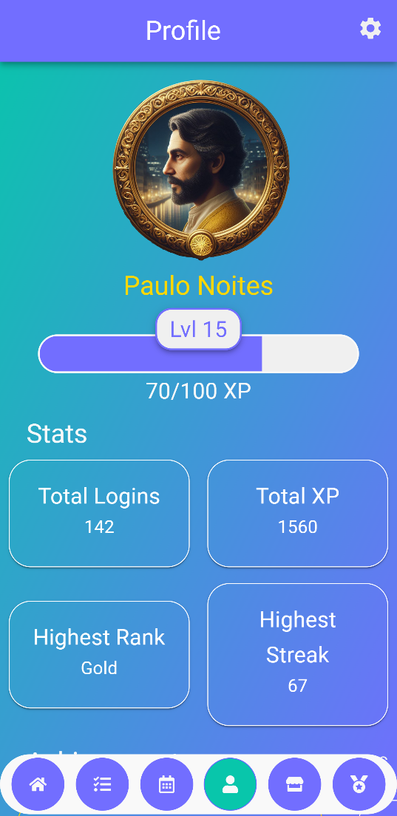
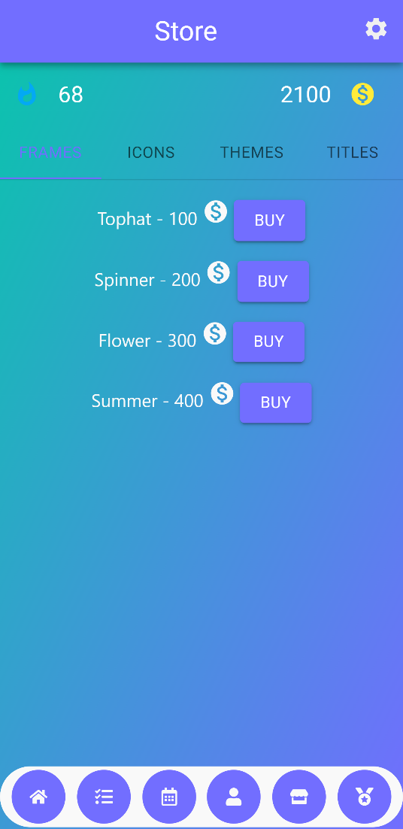
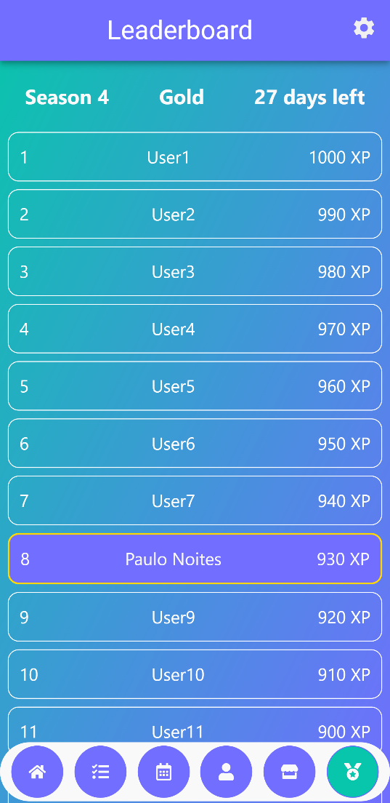
Demo

Slide 20

Future work
Fix task add menu
User database
Ranking system improvement
Integration with tools like Expo for porting
Deployment

Slide 21

Acknowledgments
Team effort:
Gonçalo Cunha, 108352 - 50%
José Cerqueira, 76758 - 25%
Vasco Rodrigues, 109211 – 25%

